Slide 1
Cayuse Research Suite
https://kansashsc.app.cayuse.com/

Slide 2
Kansas Health Science Center Institutional Review Board (IRB) and the Cayuse IRB System
Parts of this work were adapted from Alicia Scott, MPA, CIP, April Nelson, MS, CIP, and Stephanie Dixon at the Chicago School of Professional Psychology

Slide 3
About Cayuse
Cayuse Human Ethics is an IRB submission and document management system used by KHSC IRB.
Cayuse provides users with an interactive web application.
As you answer questions, new sections relevant to the research being conducted will appear.
Skip logic
Branch logic
You do not have to finish the application in one sitting – all information can be saved.
It’s a good idea to save frequently. The button is in the upper right corner.

Slide 4
How to Log in
Cayuse uses single sign-on.
You will be able to log in and access the system with your KHSC-KansasCOM credentials.
https://kansashsc.app.cayuse.com/
If you don’t come to the dashboard, select Human Ethics in the PRODUCTS menu

Slide 5
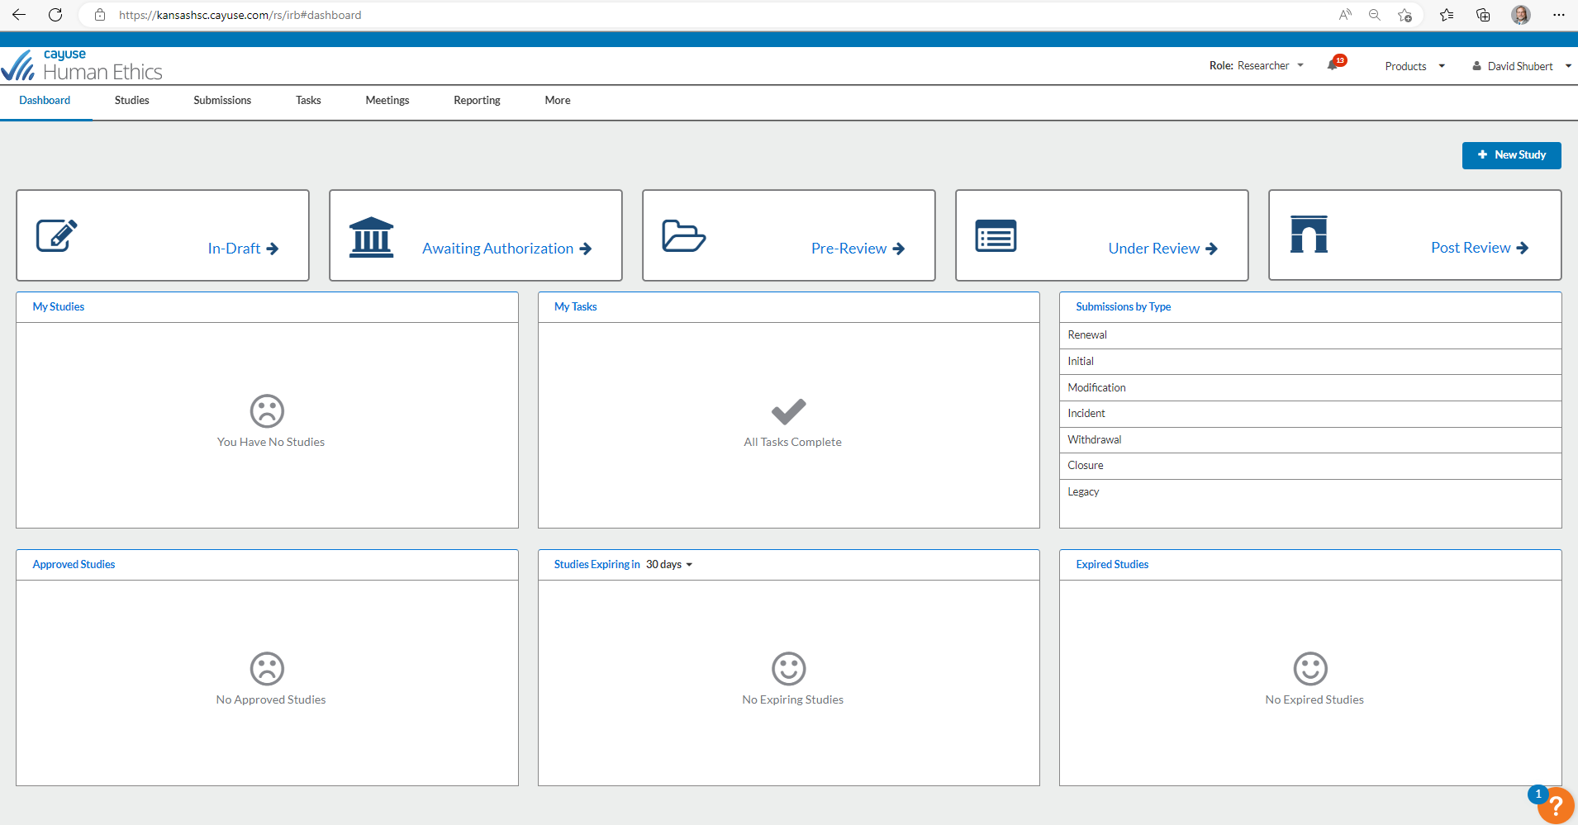
Researcher Dashboard

Slide 6
Study vs. Submission
Study
High-level information
Container for submissions
Submission
Actions within the study
Initial, Modification, Renewal, Closure, Withdrawal, Incident

Slide 7
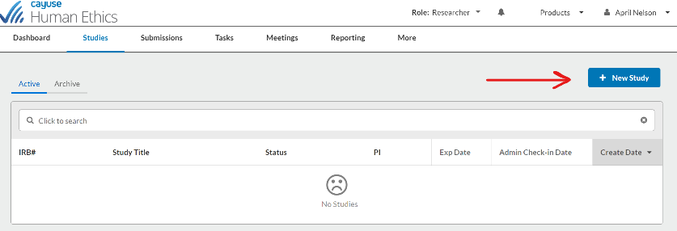
Creating a New Study
Click in the upper right-hand corner of your Dashboard or the Studies page. You will be routed to the Study Details page.
Provide a title for your study
Click to save your study.
Note the flag indicating the study’s status.
Notes:
As a Researcher, you can create a new study from your Dashboard or the Studies page within Cayuse Human Ethics.
You must create a study before creating your initial submission.

Slide 8
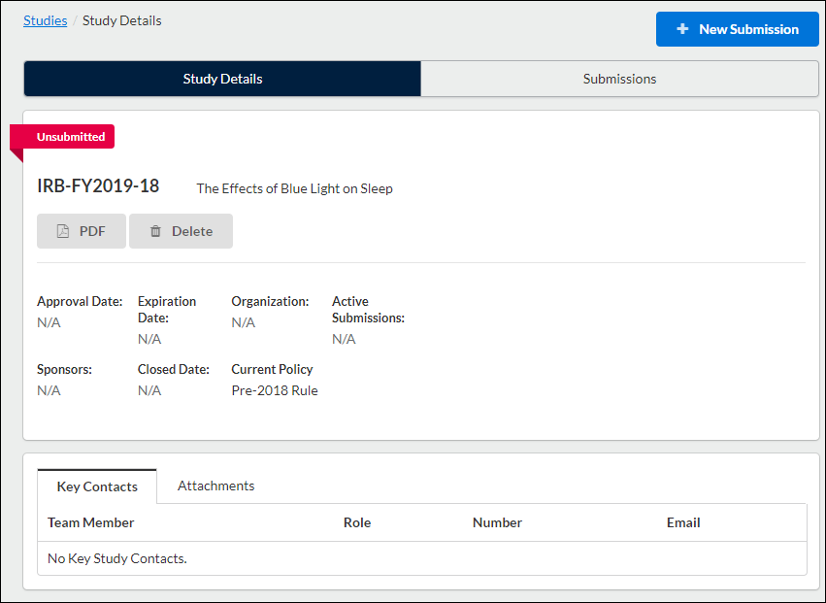
Study Details Page
Notes:
After creating your study, you will be taken to the Study Details page. Here, you will see where important study information will populate once you begin your submission

Slide 9
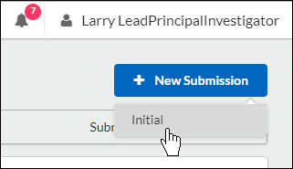
Creating an Initial Submission
You can begin completing forms for your initial submission by clicking on New Submission, and then clicking Initial from the drop-down menu.
Once the submission has been submitted, certified, and approved, choices will include other options such as Incident Report, Withdraw, Close.
Notes:
Submission information will populate beneath the Submission Details tab.
The person who creates the study is added as the Primary Contact by default, but this can be changed when editing the submission.
Make sure to not remove yourself from all roles and Save, or you will not be able to access your submission once you leave.
Once on your institution's initial submission form, you can return to the Submission Details page by clicking on Study in the upper left-hand corner of the screen.

Slide 10
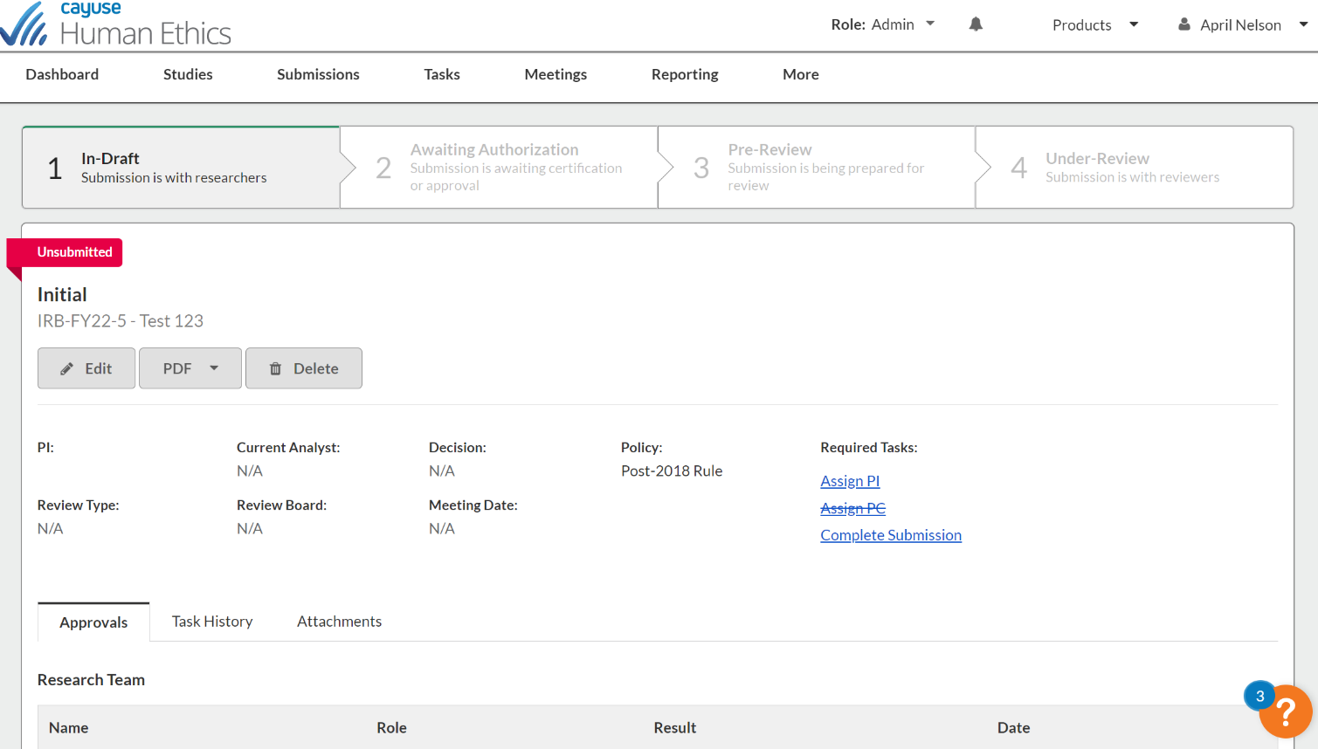
Edit Submission
Click on to begin your submission forms. You will always be able to return to your incomplete submission by clicking this button.
Notes:
Submission information will populate beneath the Submission Details tab.
The person who creates the study is added as the Primary Contact by default, but this can be changed when editing the submission.
Make sure to not remove yourself from all roles and Save, or you will not be able to access your submission once you leave.
Once on your institution's initial submission form, you can return to the Submission Details page by clicking on Study in the upper left-hand corner of the screen.

Slide 11
Submission Guidance
Application questions must be specifically and accurately answered in non-technical language.
Not every member of the IRB has a scientific background
If technical language is required - clearly define the terms/and or concepts in the application and all study documents.
ltems with red stars are required and must be completed to submit.
Save frequently!

Slide 12
Navigating Among Sections
Click on a section name
in the menu at left to jump to that
section.
You do not have to complete the sections in any particular order.
A checkmark appears when the section is completed.
You cannot submit the request until all sections are completed.

Slide 13
Getting Started
You must click YES to bring up the other sections

Slide 14
Submission Information
Notes:
Different types of may bring up other questions (e.g., Is this a multi-institutional study?)

Slide 15
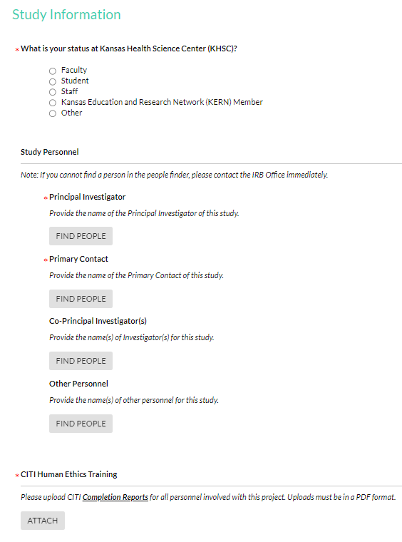
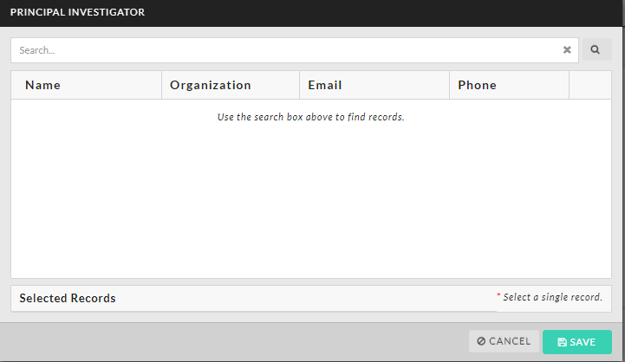
Study Information
The PI and Primary Contact are required
Can be same person
Primary Contact is by default the person entering the submission
This can be changed
These are the only persons with EDITING privileges

Slide 16
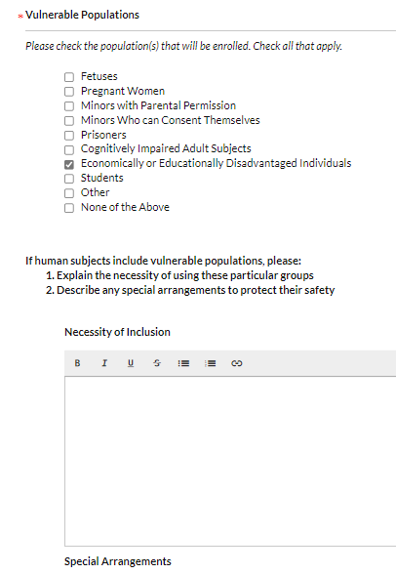
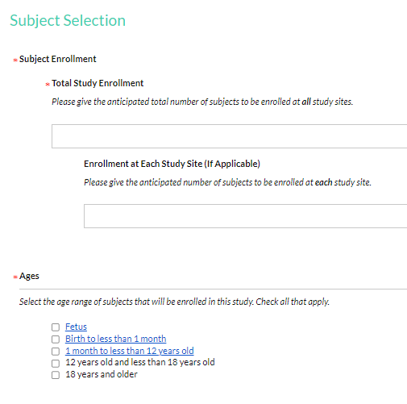
Subject Selection

Slide 17
Study Design
Other sections include
Hypothesis
Objectives
Outcome measures
Inclusion criteria
Exclusion criteria

Slide 18
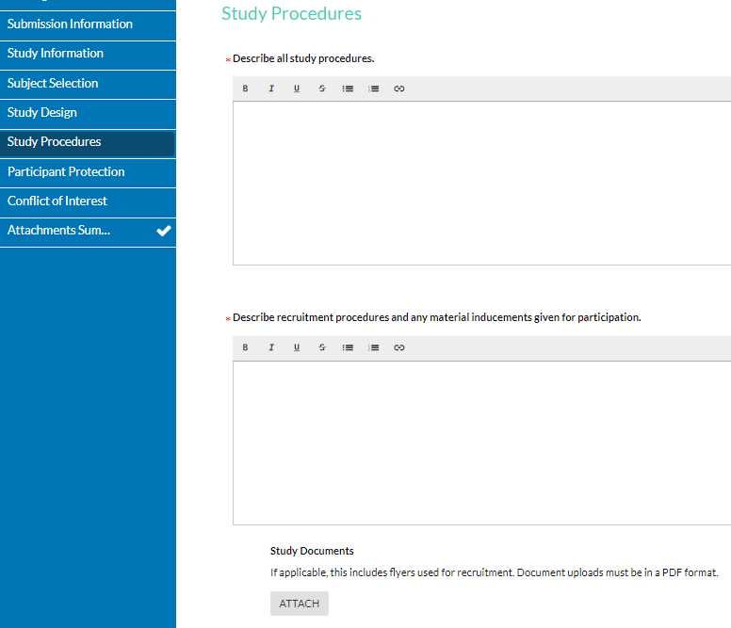
Study Procedures
Notes:
You can upload documents in the sections or in the Attachment summary.

Slide 19
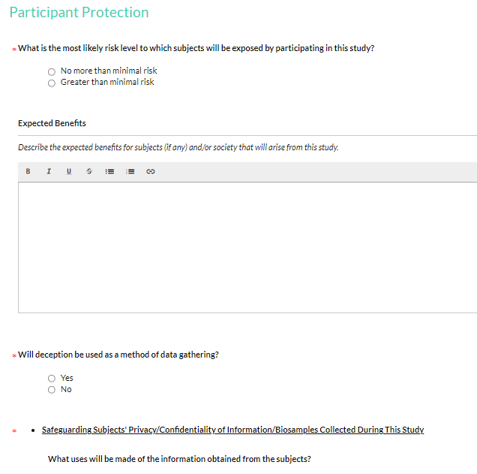
Participant Protection
Notes:
If you choose greater than minimal risk, additional information will be requested.

Slide 20
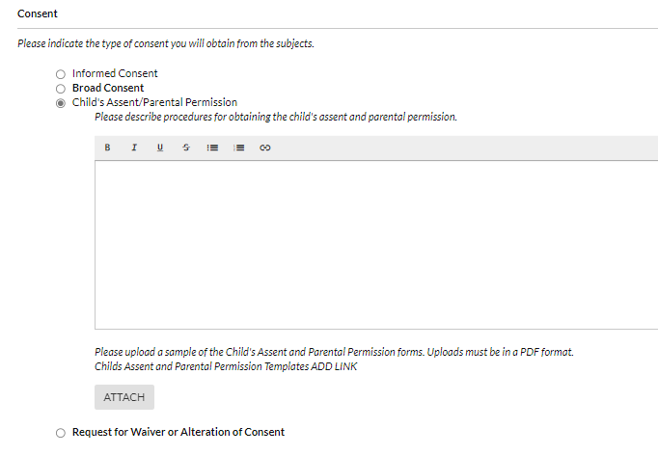
Participant Protection

Slide 21
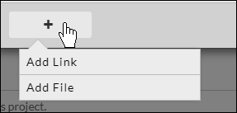
File Uploads
You can upload one or more files to the study by clicking
You can upload files in the sections or at the end of the document (ATTACHMENT SUMMARY).
Please upload all documents as PDF files.
This allows reviewers to stamp the document.
You can also include hyperlinks as "attachments" by choosing Add Link from the + drop-down menu.
Notes:
You can also include hyperlinks as "attachments" by choosing Add Link from the + drop-down menu.

Slide 22
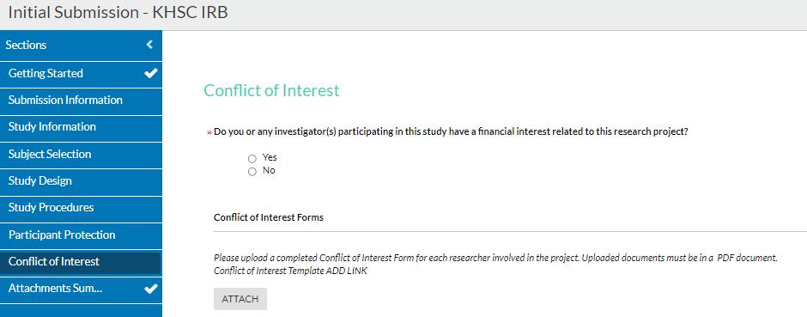
Conflict of Interest

Slide 23
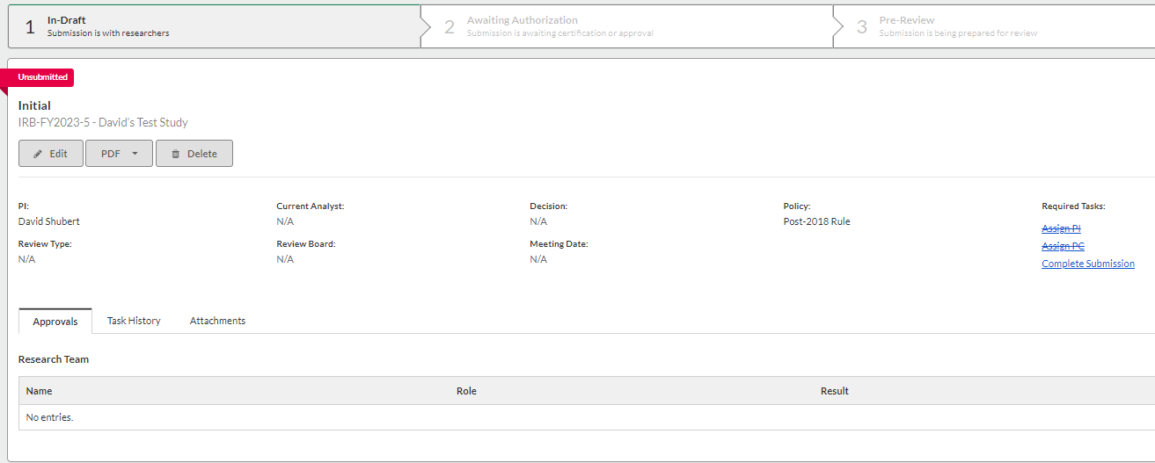
Completing a Submission
Dashboard => In-draft => Complete Submission
CLICK
Notes:
•The Complete Submission button will only appear when you have check marks next to all your sections. If one of your sections does not have a check mark, and you aren't sure why, click on the section to search for any required questions you may have missed.

Slide 24
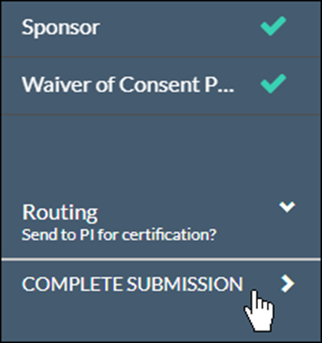
Completing a Submission
Once you have filled out every section of your submission, and have added all required attachments, a Complete Submission option appears beneath Routing within the menu on the left side of the screen.
After clicking Complete Submission, you will be prompted to Confirm or Cancel.
Notes:
Once you have filled out every section of your submission, and have added all required attachments, a Complete Submission option appears beneath Routing within the menu on the left side of the screen.

Slide 25
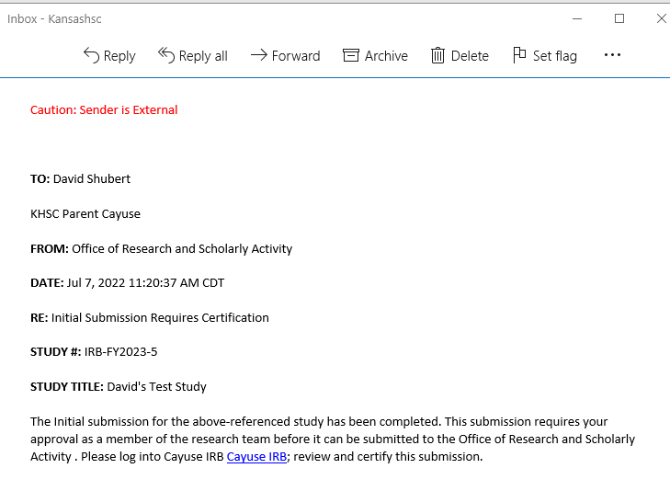
Auto Email
Notes:
Once you have filled out every section of your submission, and have added all required attachments, a Complete Submission option appears beneath Routing within the menu on the left side of the screen.

Slide 26
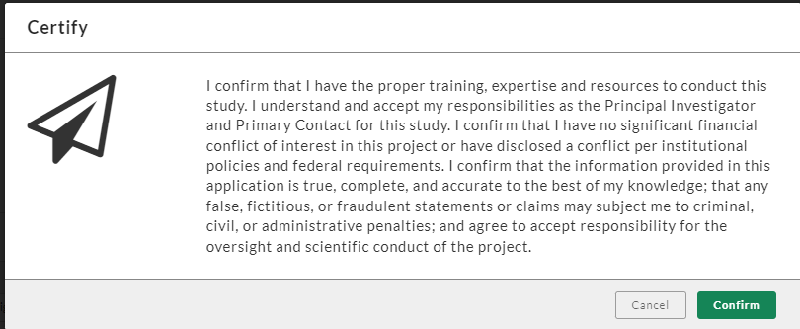
Certification PI Only
Dashboard => Awaiting Authorization => Select Study => Certify
Once the PI has certified the submission, the submission will be reviewed by the Chair and routed to the IRB office.
The submission may be returned at any point for edits or clarification
Notes:
This is a serious step.

Slide 27
IRB Submission Workflow
Workgroup/Dean Approves Research Proposal
YES
Return to PI for Editing
Primary Contact Creates Study/Enters Submission on Cayuse
YES
Questions?
IRB Analyst: Ready for Review?
YES
Full Board
Expedited
Exempt
IRB Review
Approve

Slide 28
Reopening Your Submission
To reopen the submission and make edits, click on the button within Submission Details.

Slide 29
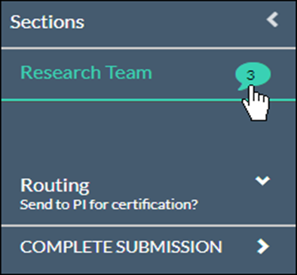
How to Address Comments
Sections with unresolved comments have a comment bubble icon indicating the total number of unresolved comments in that section.
Click on the section to see which questions have a comment attached.
Notes:
When a submission has been certified by a PI and sent to the IRB office, or other individuals reviewing the submission, may comment on various questions within the submission forms.
The IRB office will return the submission to the investigators, and the investigators will need to address any of the comments.

Slide 30
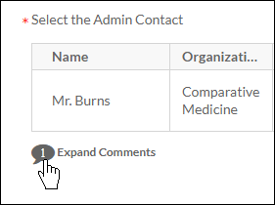
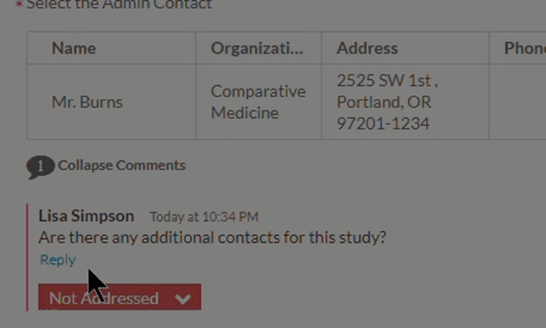
Viewing Comments
Click on the numbered comment bubble to view the unaddressed comments associated with each question.
If applicable:
Click Reply.
Enter your comment.
Click Save.
Notes:
Be sure to make the changes in the application, not the comment box. Do not attach updated document versions in the comment boxes. These sections are available to provide clarification or ask questions – not to make the changes requested by the IRB.

Slide 31
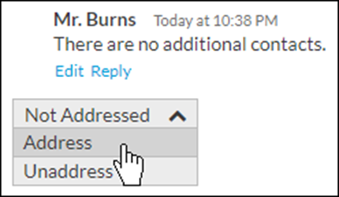
How to Address Comments
Once you have resolved an issue, change the status drop-down
from to .
You must mark all comments as addressed before the submission can be completed.
Once all comments on the submission have been addressed and the submission has been completed, the PI will need to re-certify the submission to return it to the IRB office.

Slide 32
How to Get Help
Help Text Resource Center Cayuse Help Center KHSC IRB

Slide 33
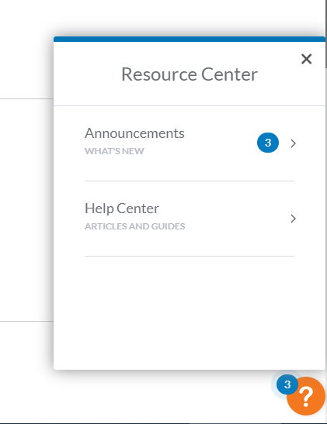
Resource Center
Assistance and articles can be found by clicking the orange question mark at the bottom-right corner of each application page.
Notes:
The articles will be relevant to what you are working on. There is also a direct link to the Help Center.

Slide 34
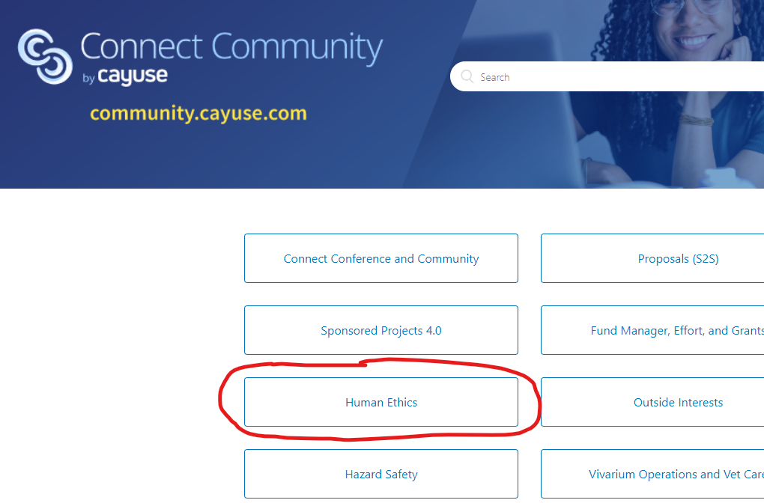
Cayuse Help Center
For more information about the submission process, tracking, tasks, or technical support, please go to support.cayuse.com.
You will need to create a separate username and password for the Cayuse Help Center, as access to this site does not use the TCSPP single sign-on (SSO) credentials.

Slide 35
KHSC IRB
Email: kansashscirb@kansashsc.org
Website: https://community.kansashsc.org/irb

